Slide 1
Data Science Basics in R:
Day 1

Slide 2

Introductions

Slide 3
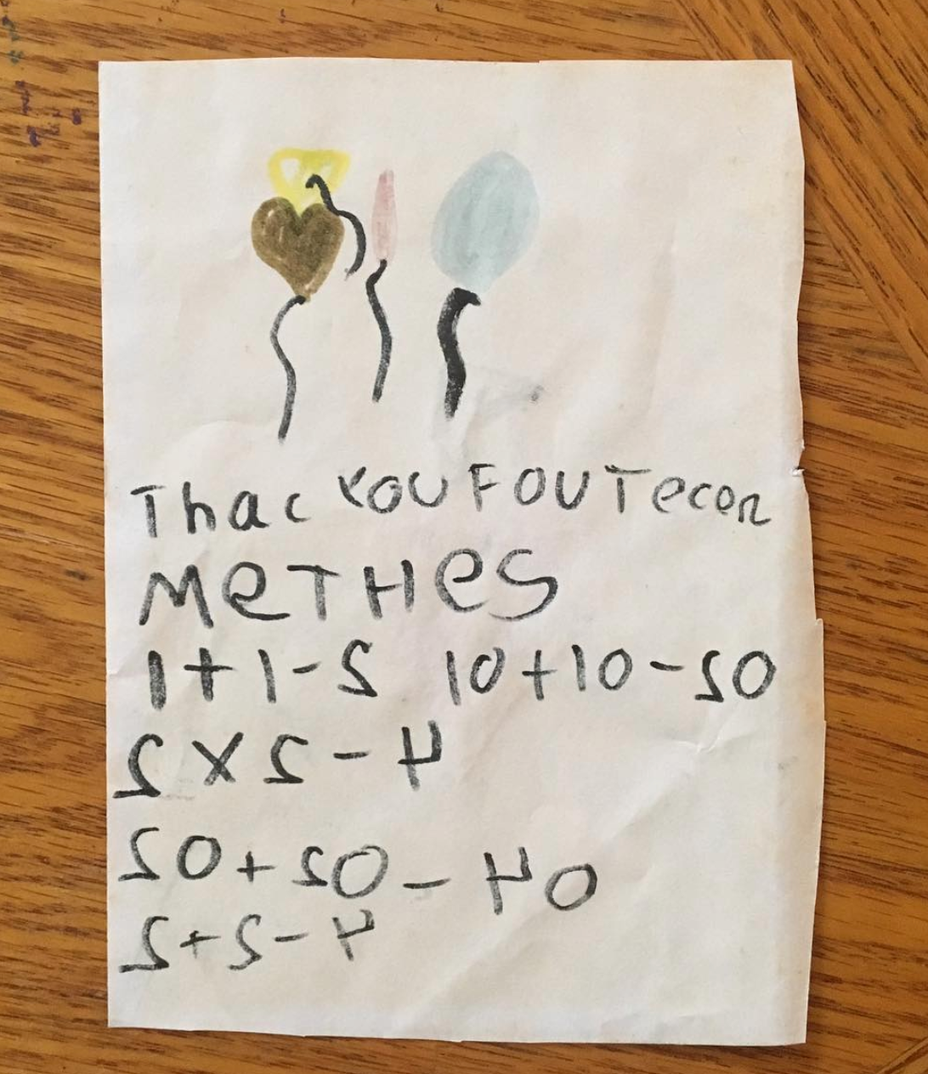

Introductions

Slide 4
Introductions
Your name
What you do for school, work, and/or fun
Why you signed up for this class
Have you ever used R before?

Slide 5
Housekeeping notes
Take a break whenever you need one, we will also have a few structured breaks as a larger group
Outlet locations
Trash cans
Try to come with a charged laptop

Slide 6
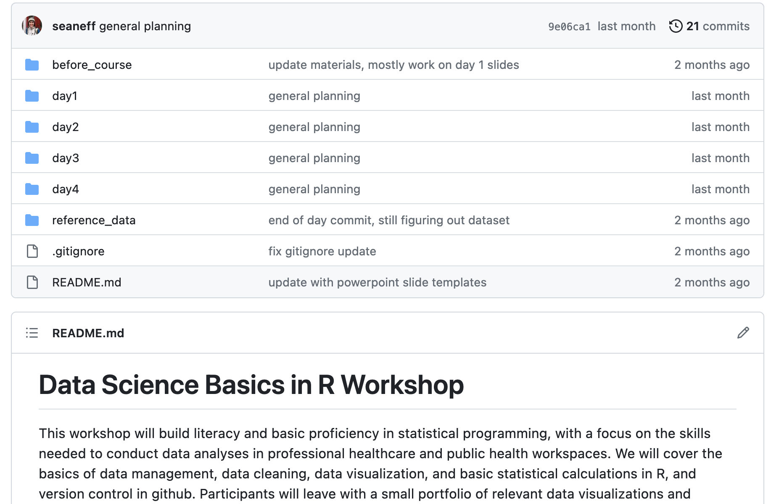
Housekeeping notes
All course materials are on github, and we’ll take more about github starting tomorrow
https://github.com/seaneff/data-science-basics-2023

Slide 7
What to expect: learning R
Learning R is fun! And also frustrating.
You won’t be an expert by the end of these 4 days.
But over time and as you practice, it gets easier!

Slide 8
What to expect: the next 4 days
We’ll balance slides/demos with hands-on time
You decide how you learn best
listening with your computer away
laptop out and typing along…
taking notes with paper/pen
If you are constantly responding to work emails or Slack messages during our time together, you’ll probably have trouble following along (I can be guilty of this too)

Slide 9
Workshop goals
This workshop will build literacy and basic proficiency in statistical programming, with a focus on the skills needed to conduct data analyses in professional healthcare and public health workspaces.
We will cover the basics of data management, data cleaning, data visualization, and basic statistical calculations in R, and version control in github. Participants will leave with a small portfolio of relevant data visualizations and analyses completed using a real‐world public health dataset.

Slide 10
Workshop goals
This workshop will build literacy and basic proficiency in statistical programming, with a focus on the skills needed to conduct data analyses in professional healthcare and public health workspaces.
We will cover the basics of data management, data cleaning, data visualization, and basic statistical calculations in R, and version control in github. Participants will leave with a small portfolio of relevant data visualizations and analyses completed using a real‐world public health dataset.
Learning to program (in R) can be fun, and doesn’t have to be overwhelming or intimidating

Slide 11
Learning by doing
For some people, it’s easier to learn by doing, typing, and making mistakes. I’m one of those people. Others prefer to listen, think, and work through problems later on their own.
In this workshop, we’ll pause to do worked examples. Sometimes these will be confusing. This is the point! We will learn together by trial and error.
If you are more comfortable following along, and you feel stuck, feel free to just watch and try at home. But I really encourage you to try, the best way to learn R is to repeatedly do stuff wrong and then figure out the errors.

Slide 12
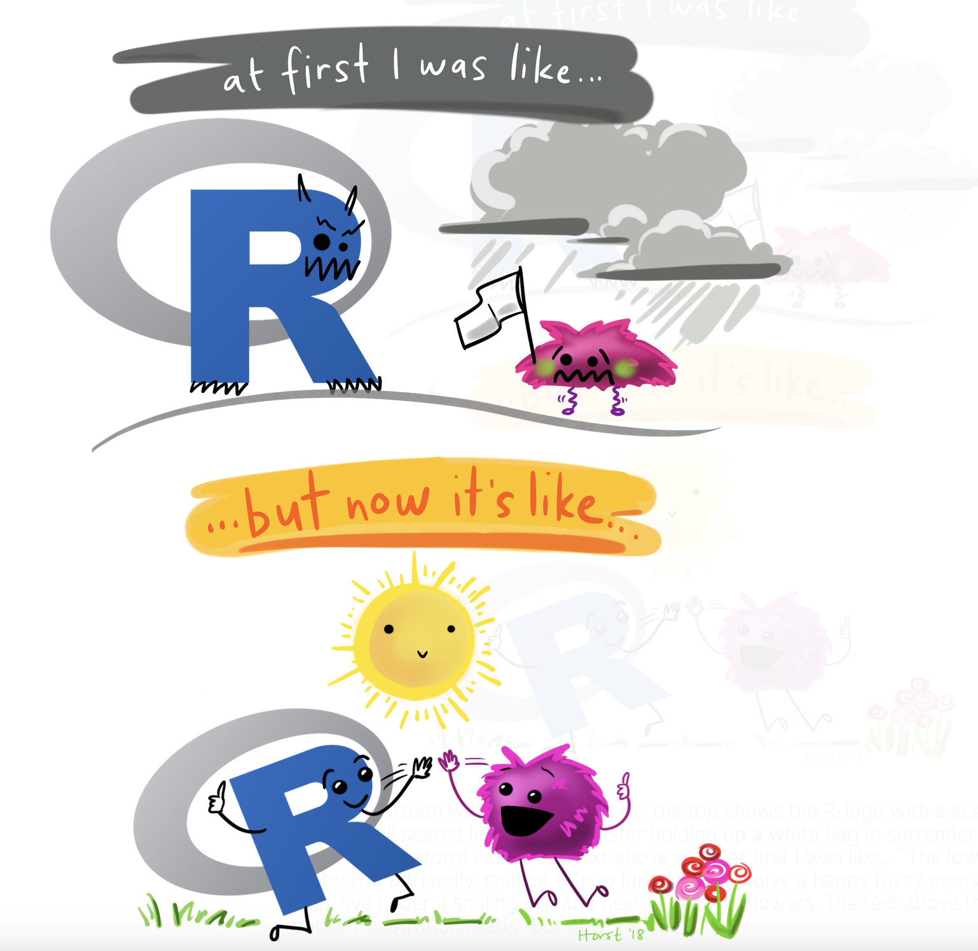
Artwork by Allison Horst
https://allisonhorst.com/everything-else

Slide 13
Goals for today
Understand what statistical programming is
Get acquainted with Rstudio
Write your very first R code (at least, of this workshop)
vectors
functions
accessing documentation

Slide 14
What is statistical programming, and why should I care?

Slide 15
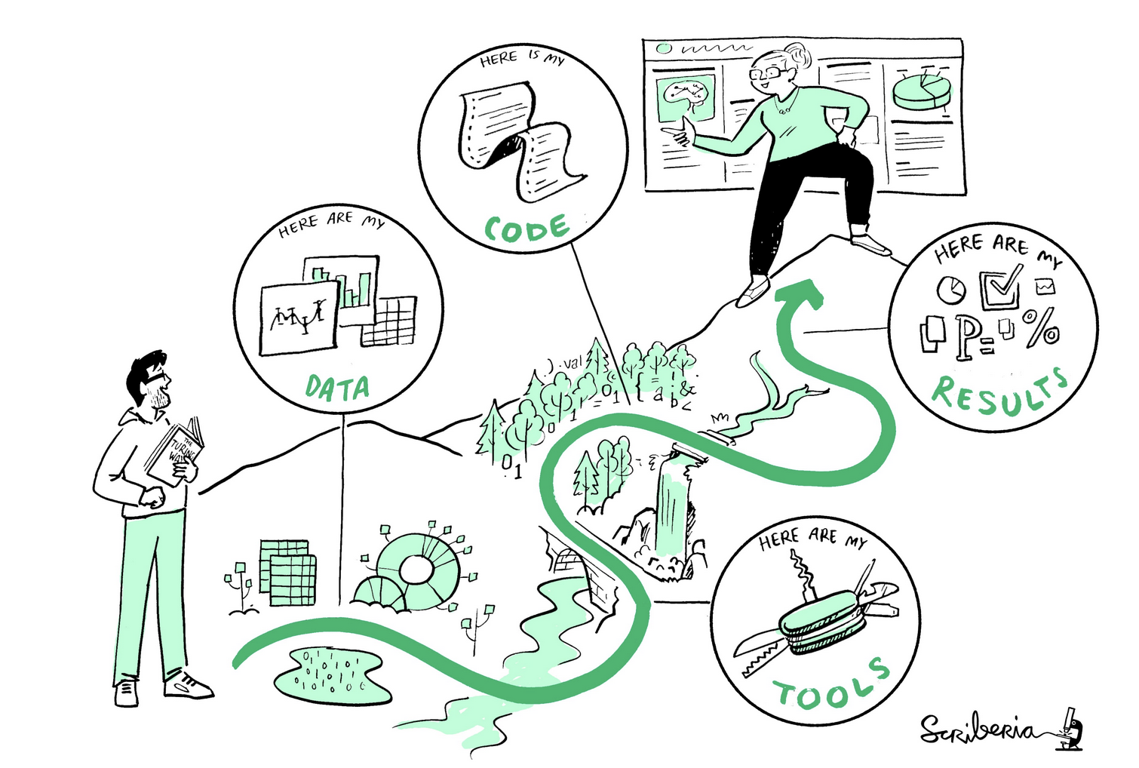
What is statistical programming?
Statistical programming is using code to clean, analyze, visualize, and interpret data
This illustration is created by Scriberia with The Turing Way community. Used under a CC-BY 4.0 licence. DOI: 10.5281/zenodo.3332807

Slide 16

What is R?
R is a programming language for statistical computing
Created by Ross Ihaka and Robert Gentleman in 1996
R is open-source and free
Many people use R in different ways and for different purposes, but it’s defined specifically for data analysis and visualization (unlike other open-source languages like python)
Notes:
See original Ihaka and Gentleman publication https://www.jstor.org/stable/1390807

Slide 17

What is R Studio?
R Studio is, put simply, a place to write and run R code
It’s an IDE (integrated development environment) and supports both R and python
It’s also free (with enterprise upgrades)
Artwork by Allison Horst
https://allisonhorst.com/everything-else

Slide 18
Why learn R?
Learning R helps you understand your data and understand how analysis works, whether you’re a researcher, a data scientist, or someone who collaborates with folks who do analysis
Coding helps you think rigorously about your questions
It’s free (vs. other more expensive tools like SAS or SPSS)
Sharable, reproducible code and research
Lots of academics/companies/agencies use it
It’s fun (honestly)

Slide 19
Getting acquainted with RStudio

Slide 20
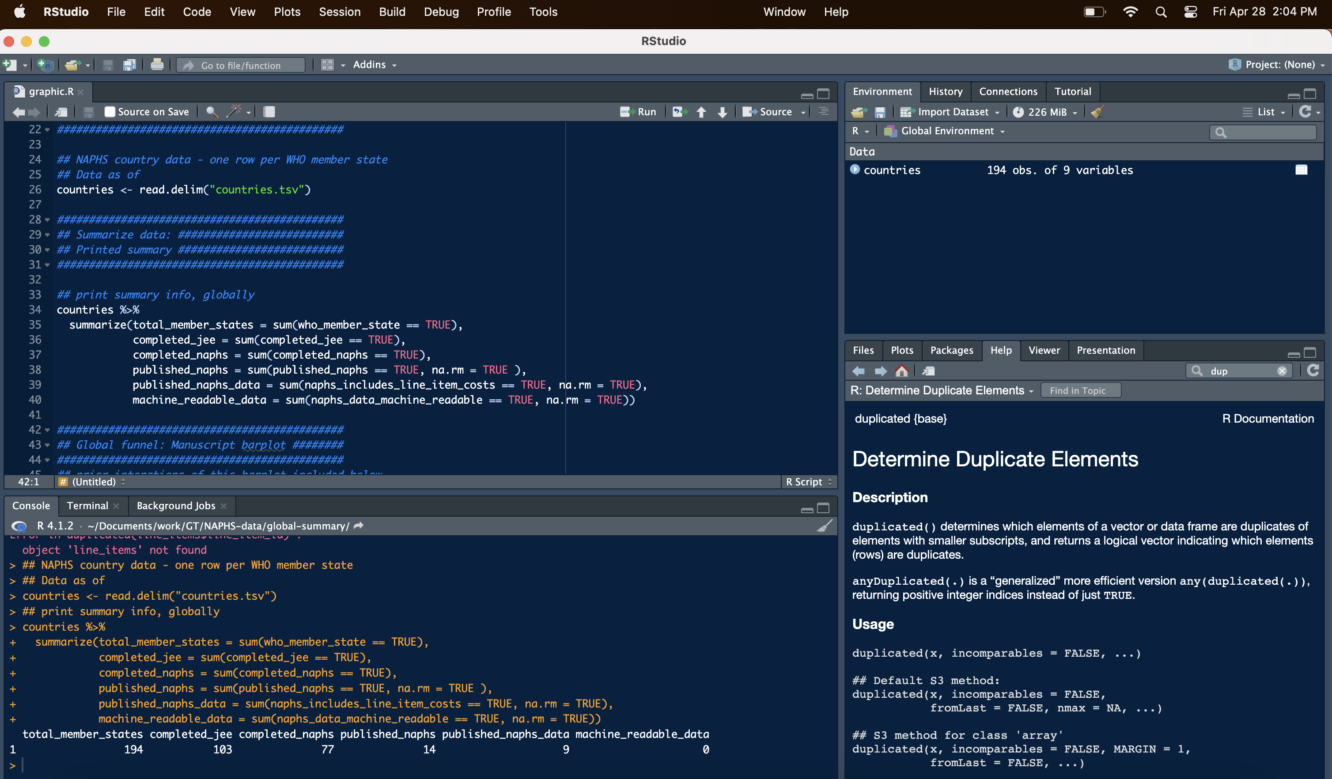
R Studio Console
Notes:
See more information here: https://intro2r.com/rstudio_orient.html#cons

Slide 21
R Studio Console
Write R scripts to re-use (.R files)
Notes:
See more information here: https://intro2r.com/rstudio_orient.html#cons

Slide 22
R Studio Console
This button runs code
(easier to see on your laptop)
Run one-off code here, or see the results of code you ran from above
Notes:
See more information here: https://intro2r.com/rstudio_orient.html#cons

Slide 23
R Studio Console
Stuff you have in memory
(e.g., datasets)
Notes:
See more information here: https://intro2r.com/rstudio_orient.html#cons

Slide 24
R Studio Console
Documentation and figures
Notes:
See more information here: https://intro2r.com/rstudio_orient.html#cons

Slide 25
Downloading R and R Studio

Slide 26
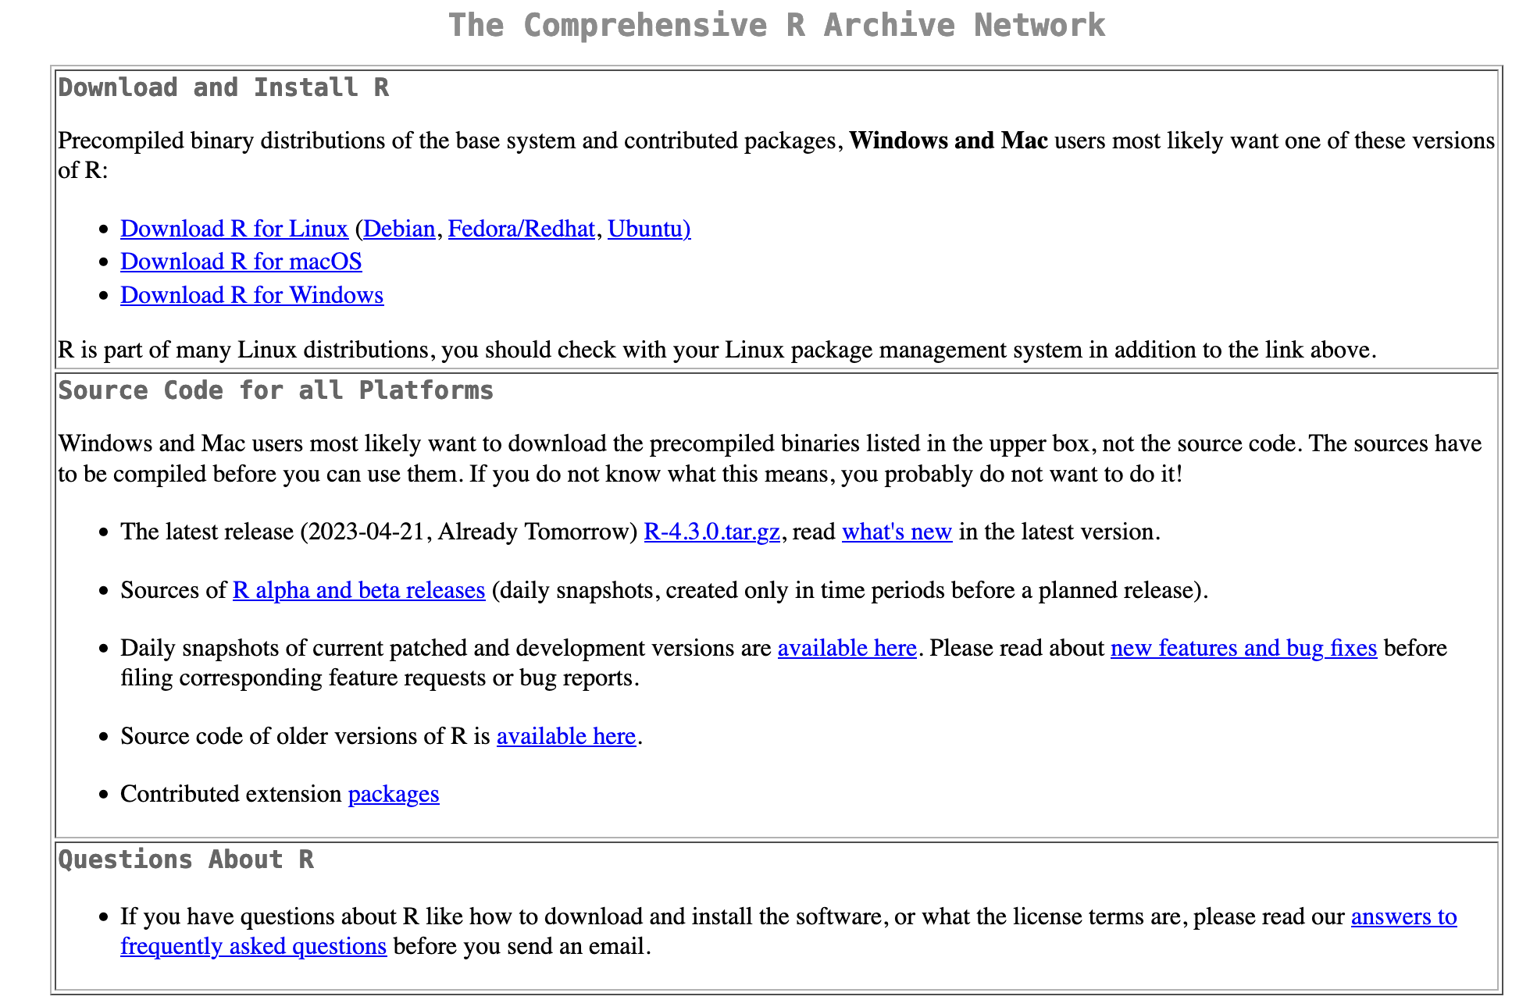
Download R:
https://cran.r-project.org/

Slide 27
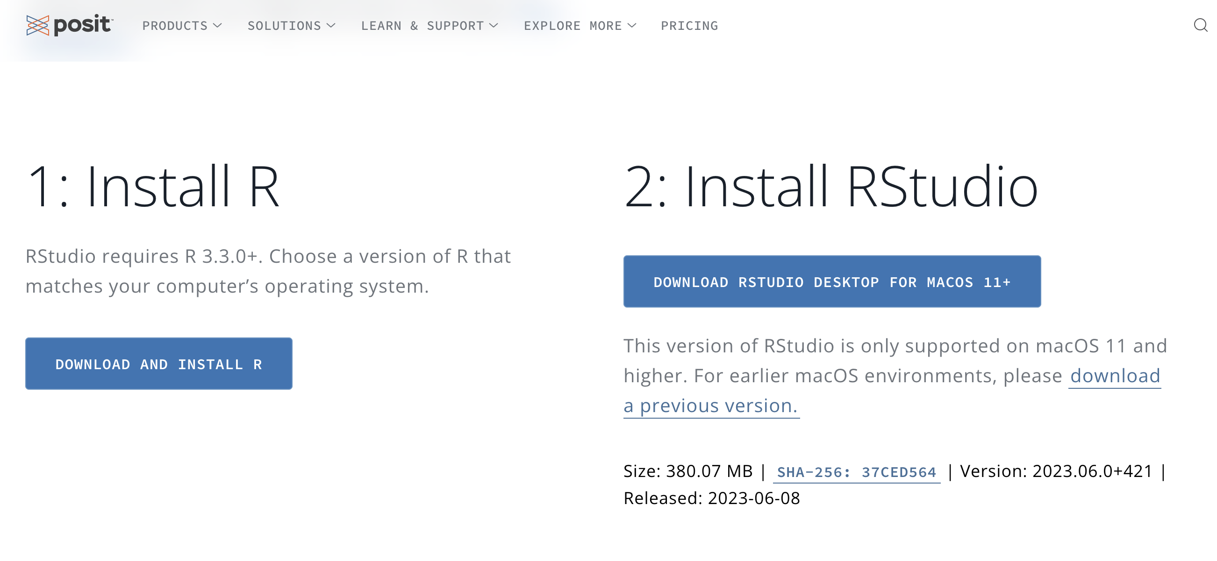
Download RStudio:
https://posit.co/download/rstudio-desktop/#download

Slide 28
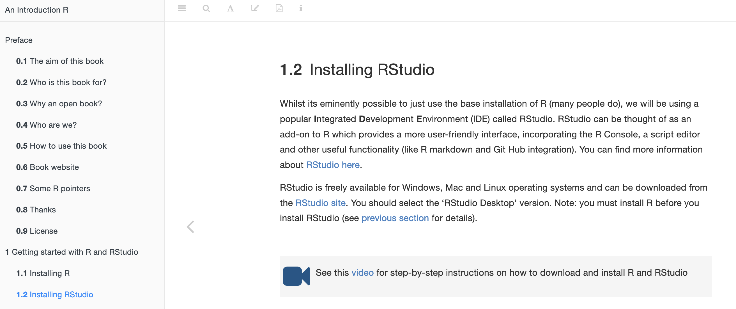
For videos and more help:
https://intro2r.com/installing-rstudio.html

Slide 29
A note on worked examples
If possible, try to download R and Rstudio before tomorrow’s class. I’ll be around by Zoom or email if you have any questions, and can help troubleshoot.
Today, we’ll do some worked examples sharing my laptop. If you already have R and Rstudio installed on your laptop, feel free to follow along there.

Slide 30
R Basics

Slide 31
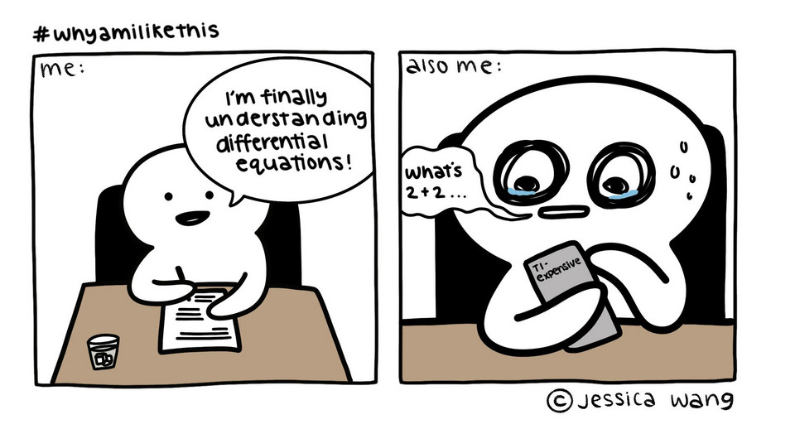
Using R as a Calculator
R can do everything a basic calculator can do
Using R as a calculator is a great first step
Comic by Jessica Wang. Accessed online: https://i.redd.it/dmayt2tc3e551.jpg

Slide 32
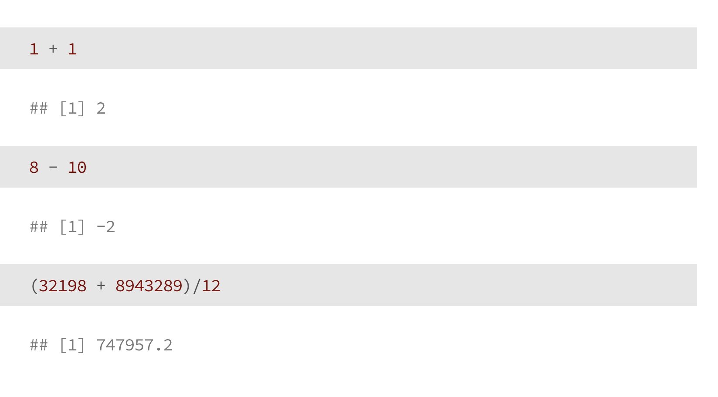
Using R as a Calculator

Slide 33
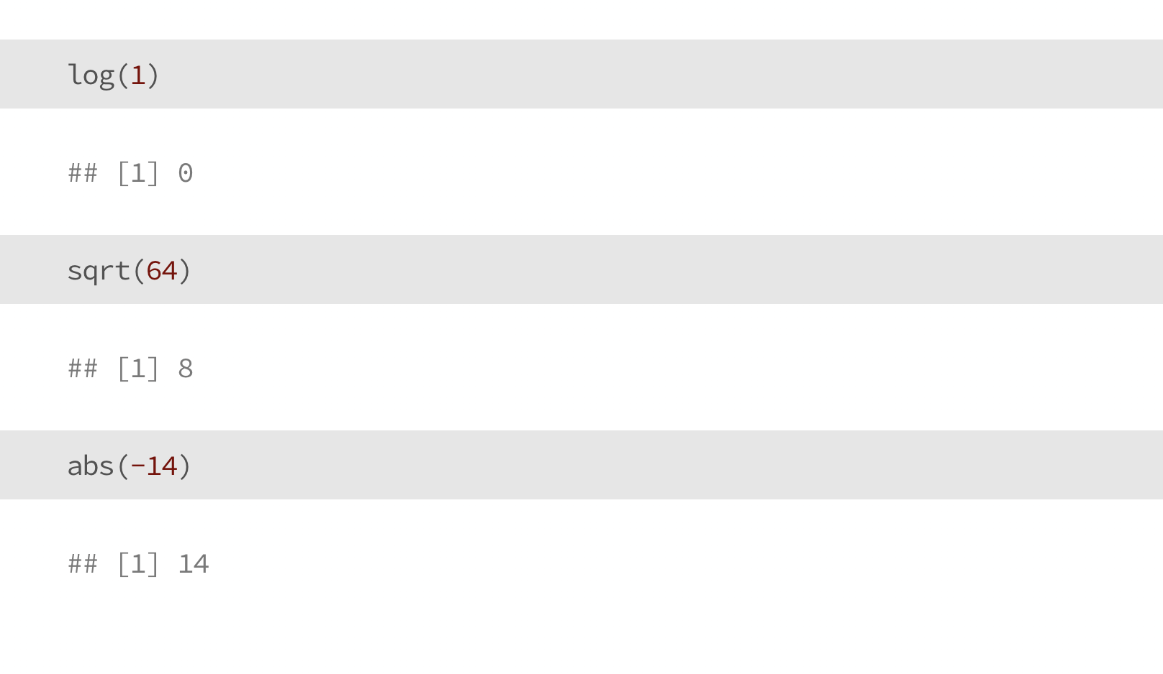
Using R as a Calculator

Slide 34
Now you try!
Use R to do some math?
Add two numbers together
Multiply three or more numbers
Take the square root of a number

Slide 35
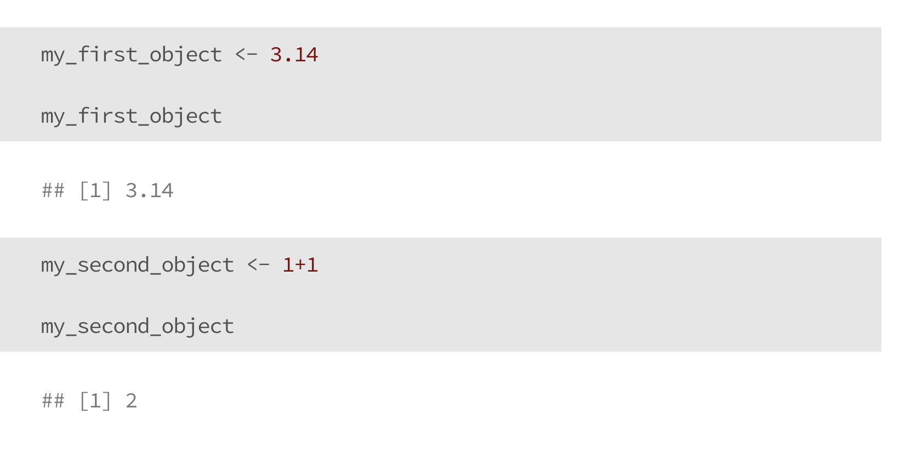
Objects

Slide 36
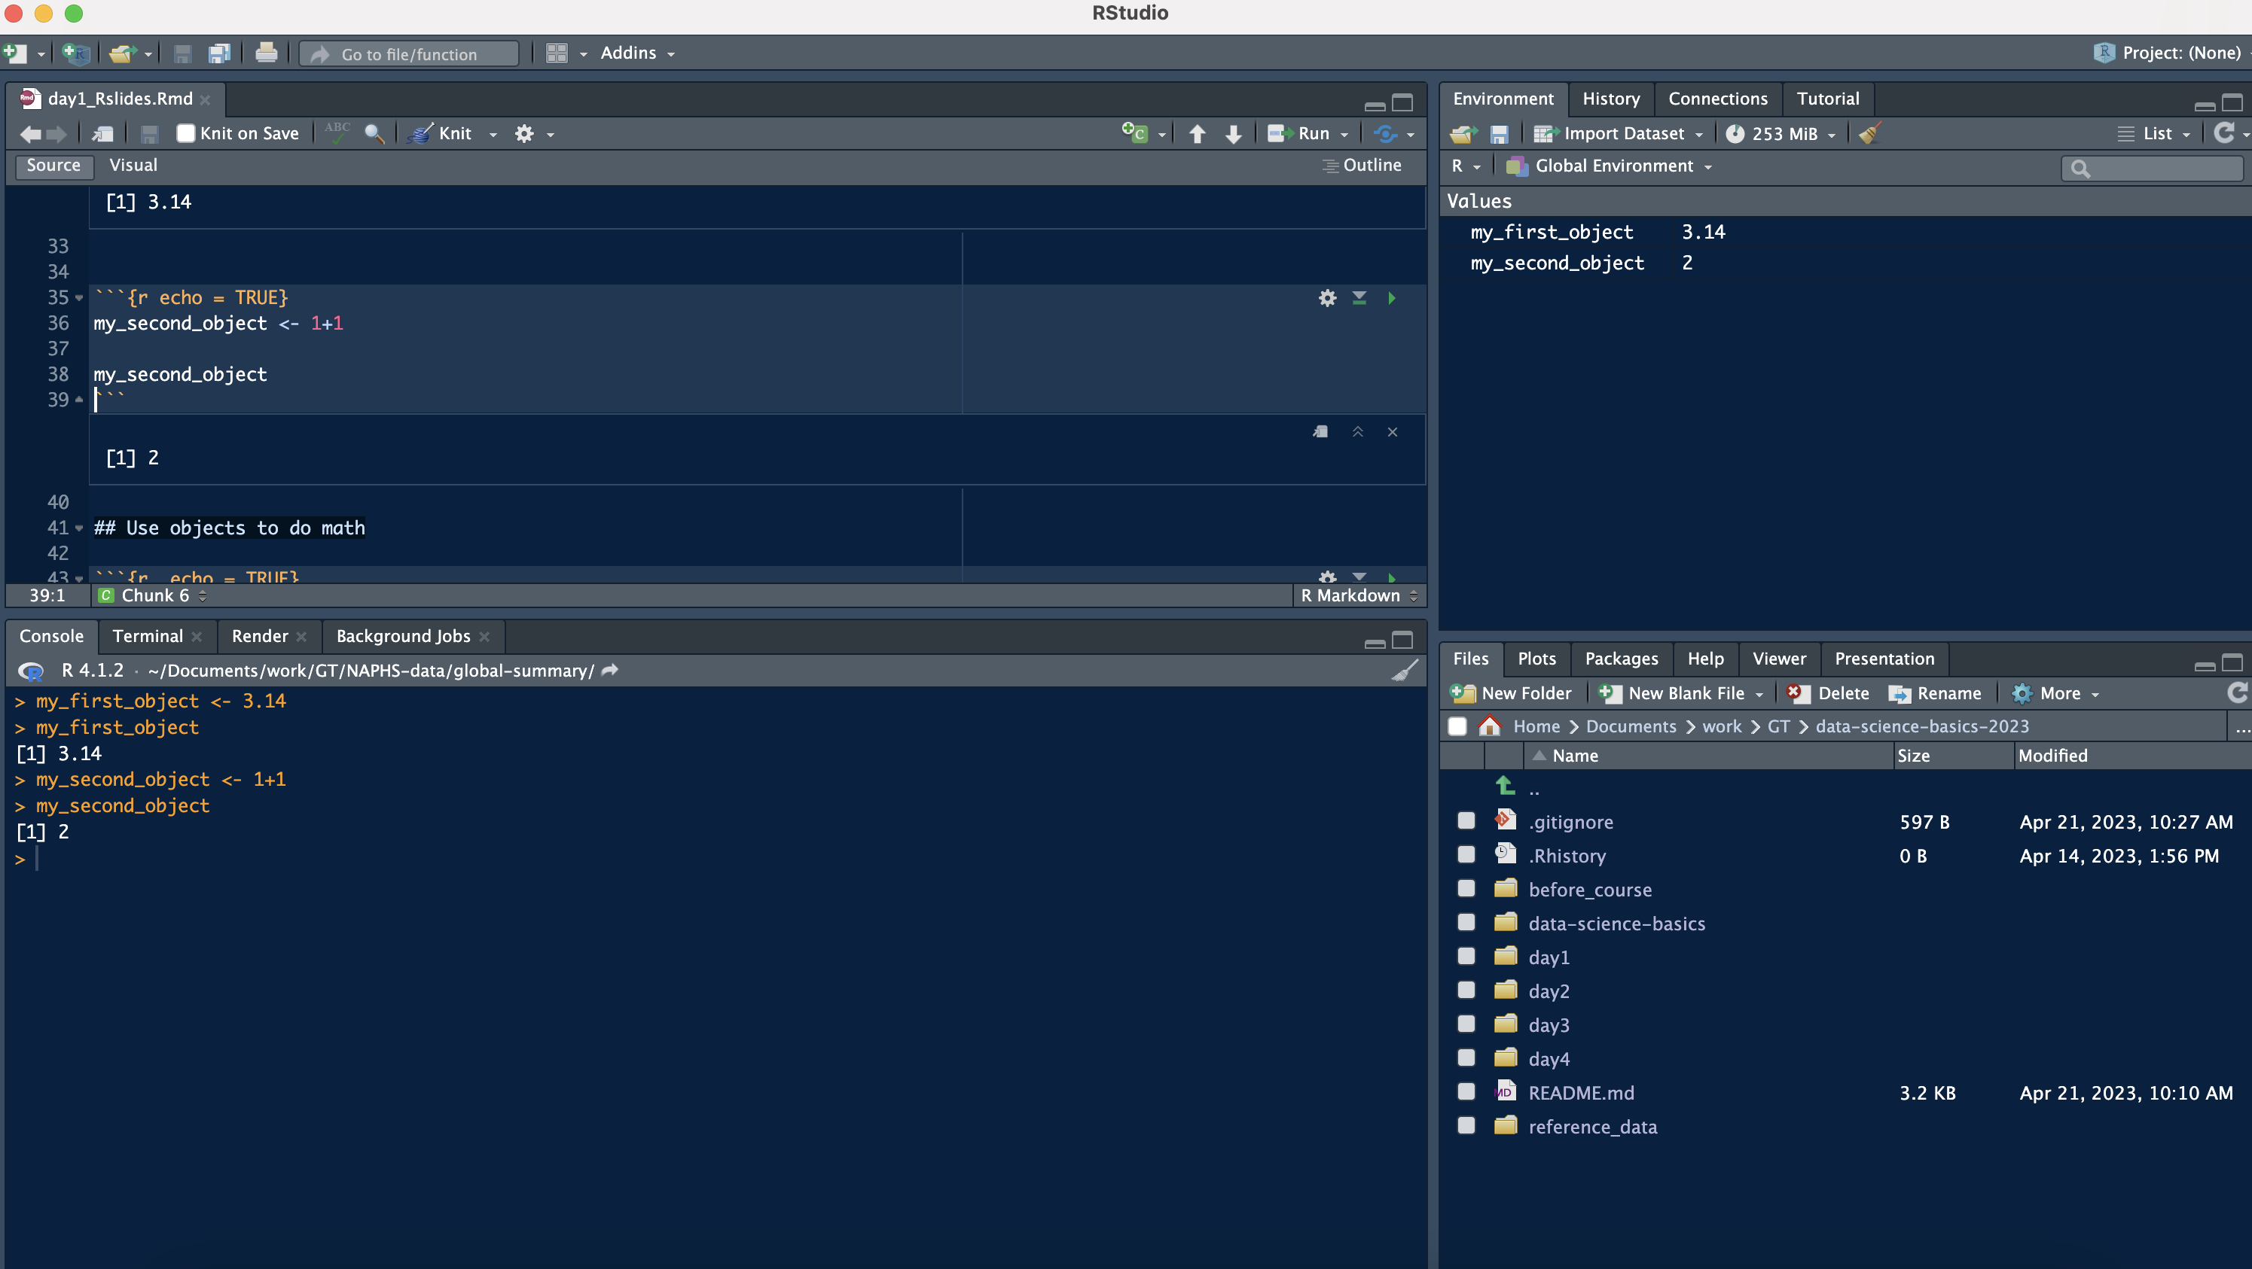
Objects
Our new objects are shown up here

Slide 37
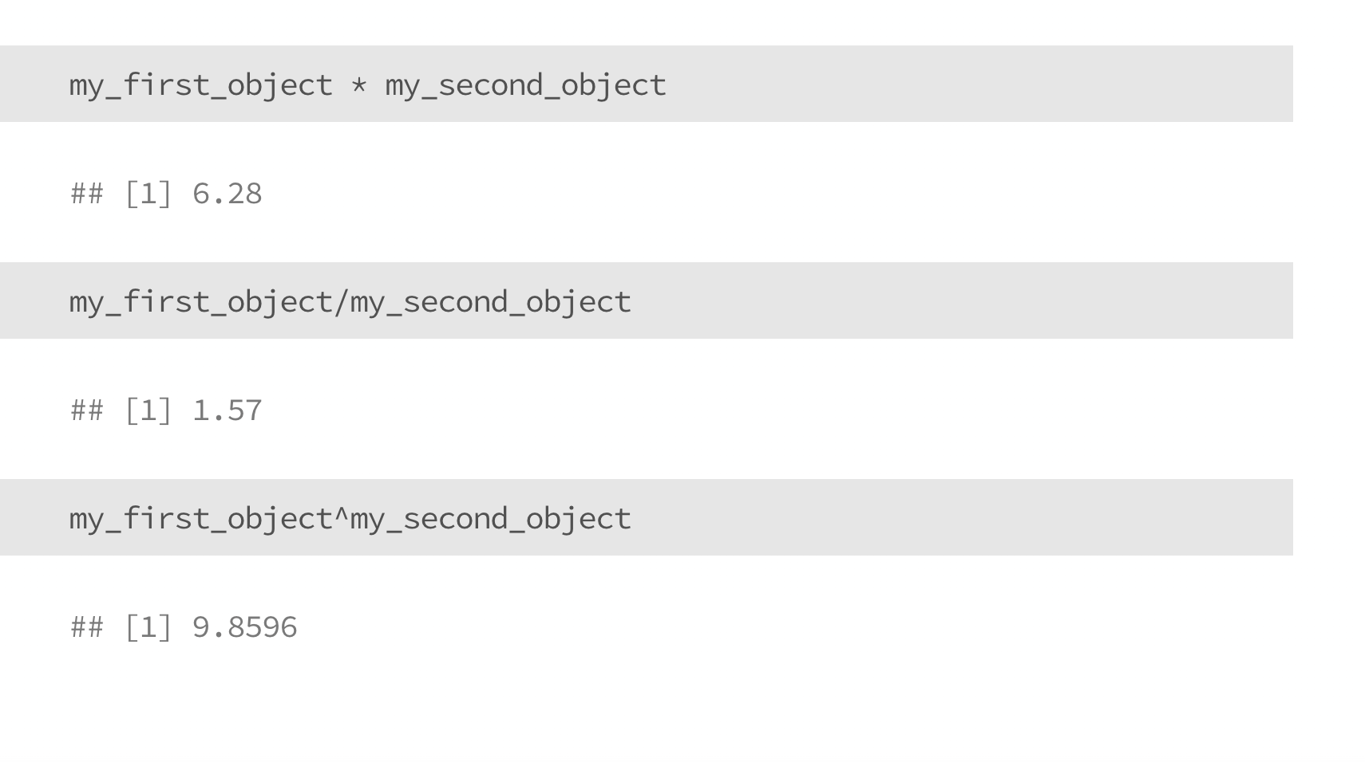
Use (numeric) objects to do Math

Slide 38
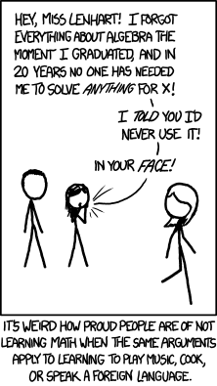
Now you try!
Pick your favorite number, and save it as an object
Pick another number, and save it as another object
Do one basic calculation (e.g., addition) with your objects
(You may run into issues, that’s okay! We’ll talk them through.)
Figure credit: XKCD

Slide 39
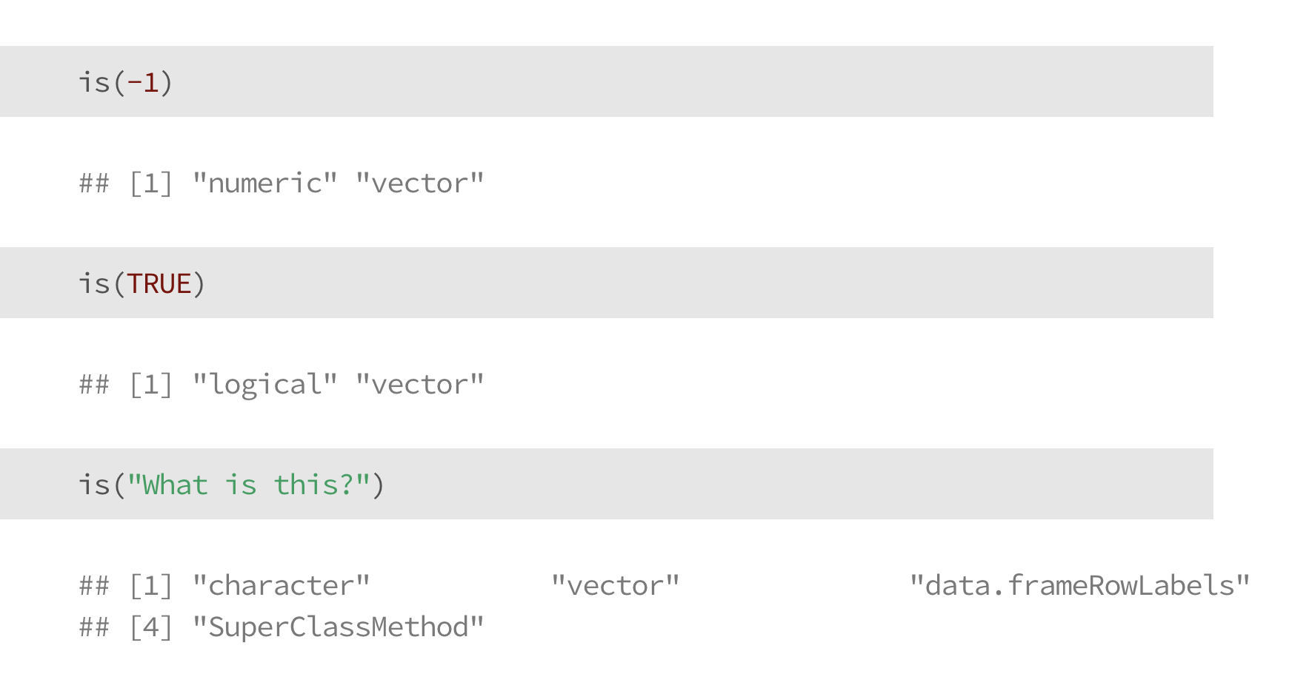
Data types in R
numeric: a number (e.g., -1, 0, 893243.343)
logical: TRUE or FALSE
character: letters and words (tricky – or a number stored as a string)
is() will help us learn the data type of a given object

Slide 40
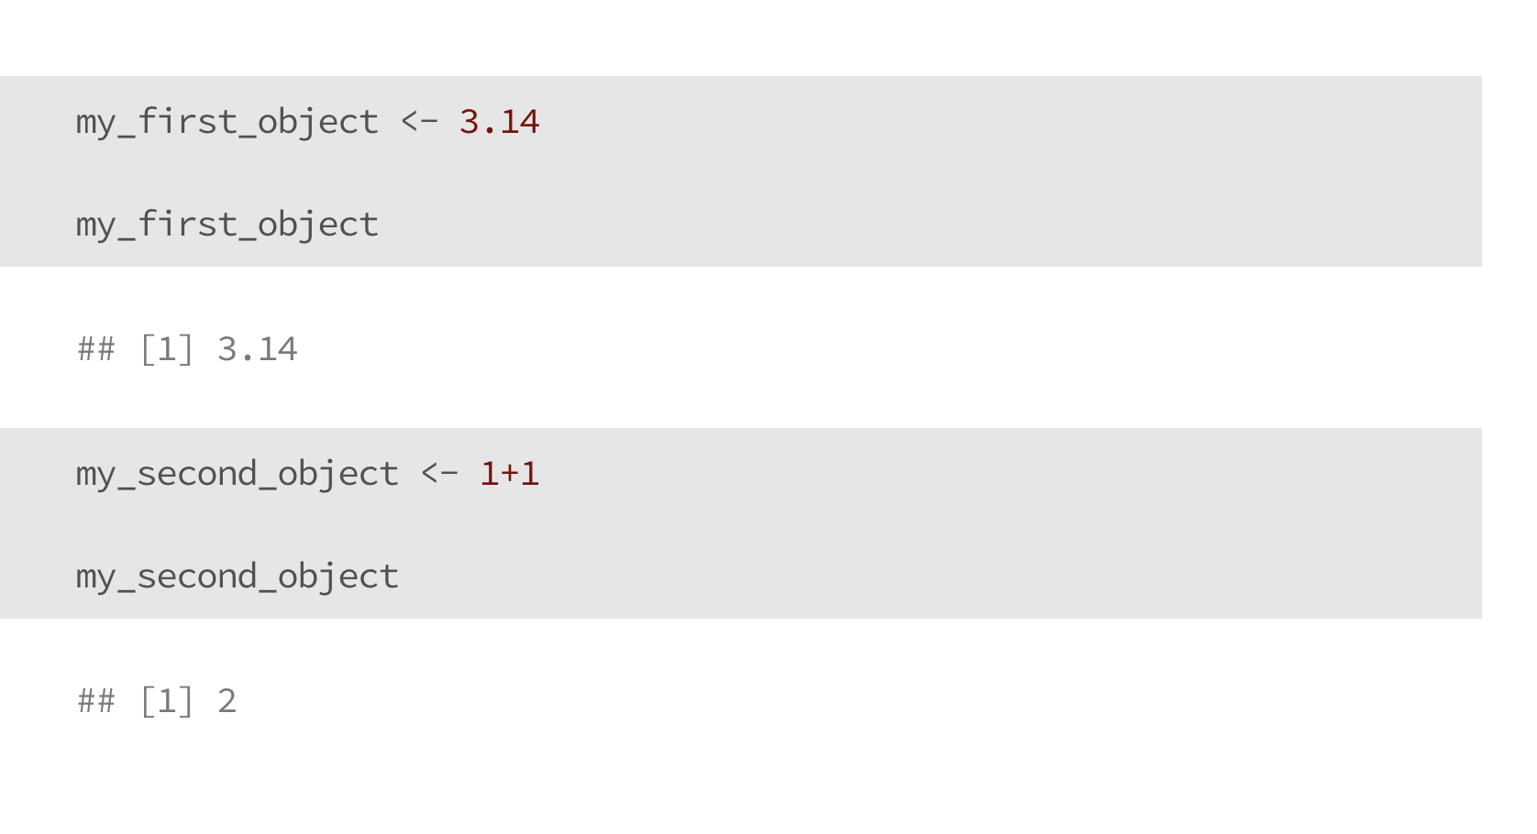
Numeric Data

Slide 41
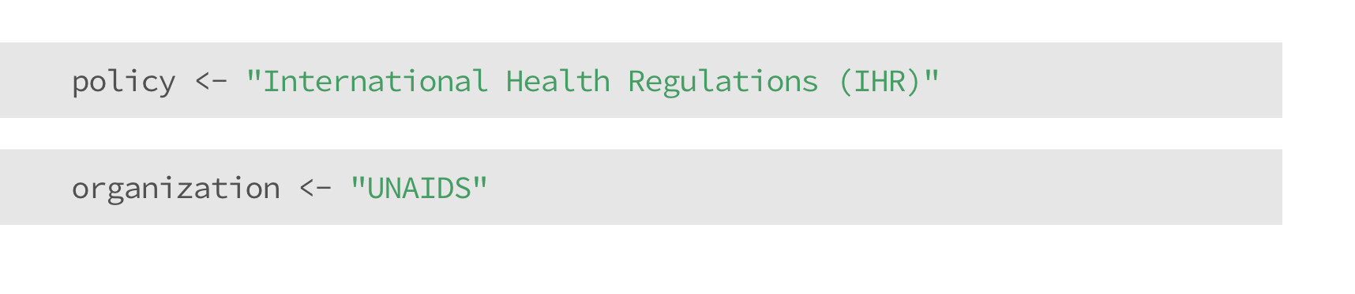
Character Data

Slide 42
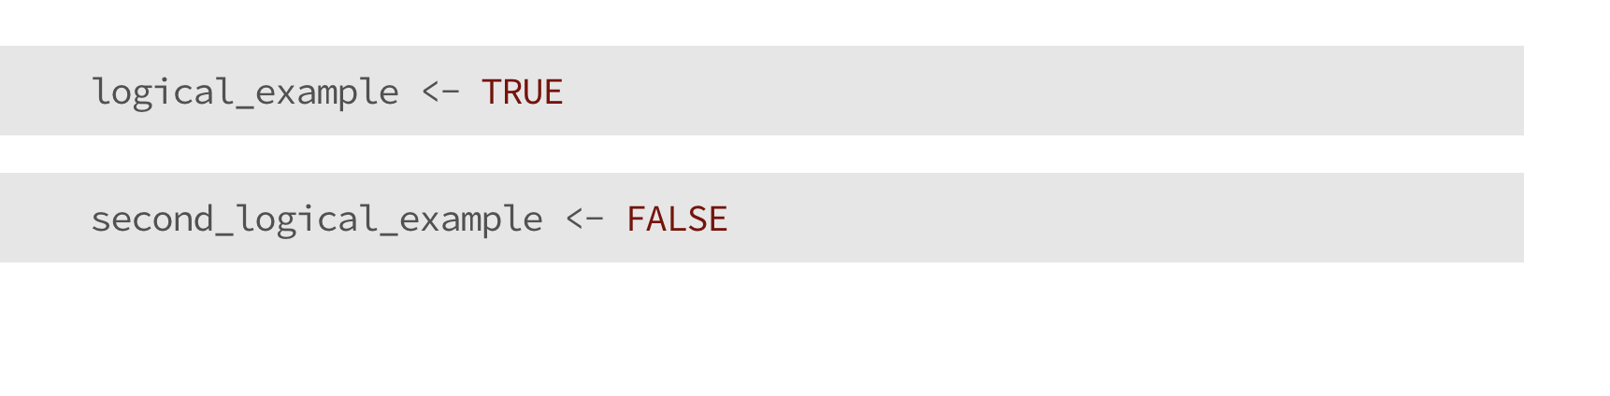
Logical Data

Slide 43
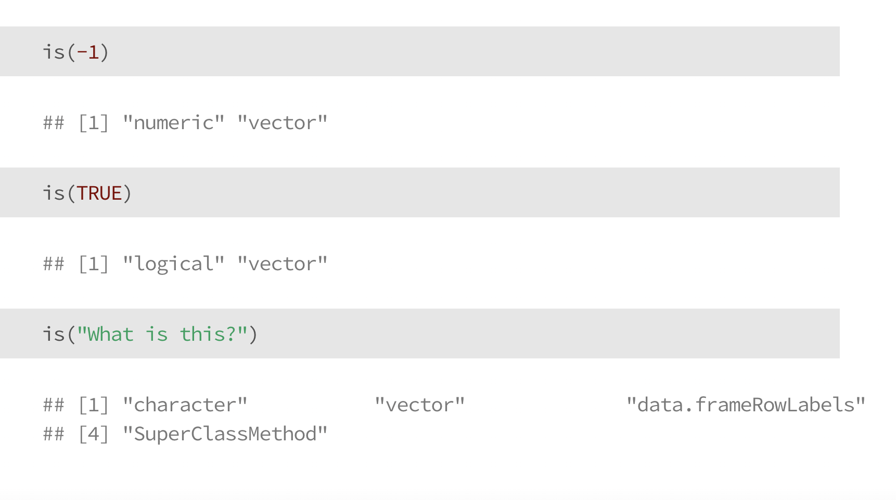
Check your understanding

Slide 44
Check your understanding

Slide 45
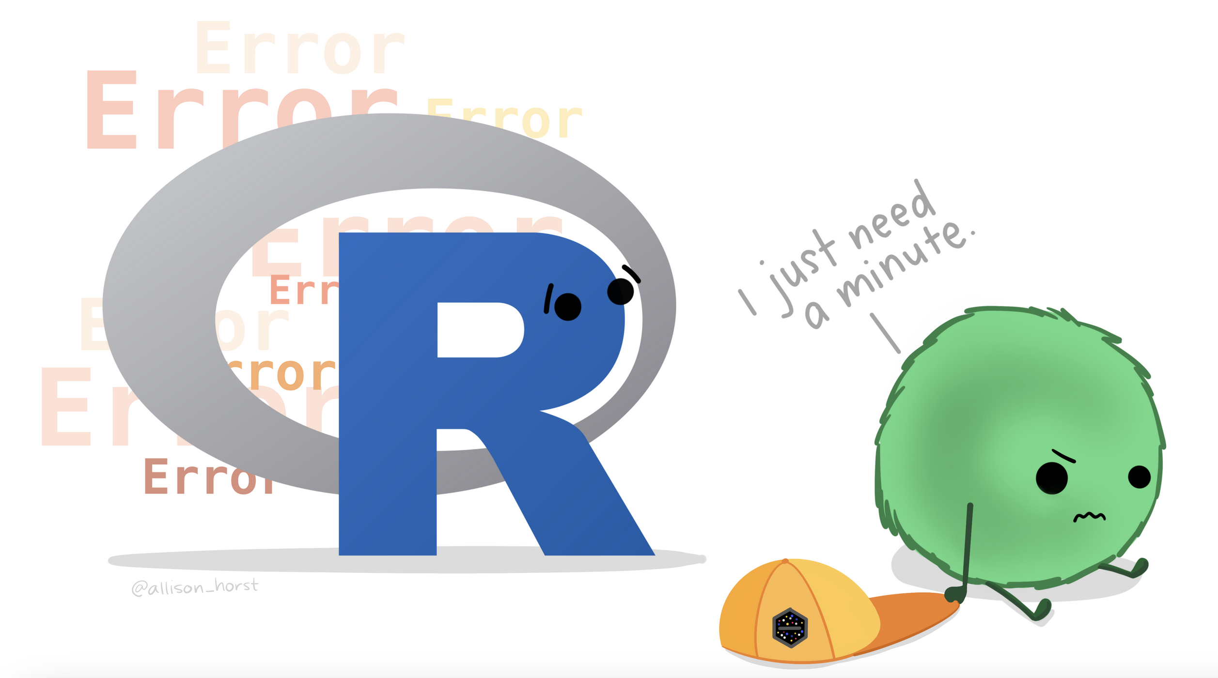
Artwork by Allison Horst
https://allisonhorst.com/everything-else

Slide 46
Rules for naming objects
General naming requirement: a variable name can’t start with a number or a dot (.)
General rules of thumb: aim for consistency
snake_case
camelCase
whatever.this.is
Chose a name you’ll understand when you open your code the next day, or when someone else reviews it
Notes:
See more information here: https://intro2r.com/objects-in-r.html#naming-objects

Slide 47
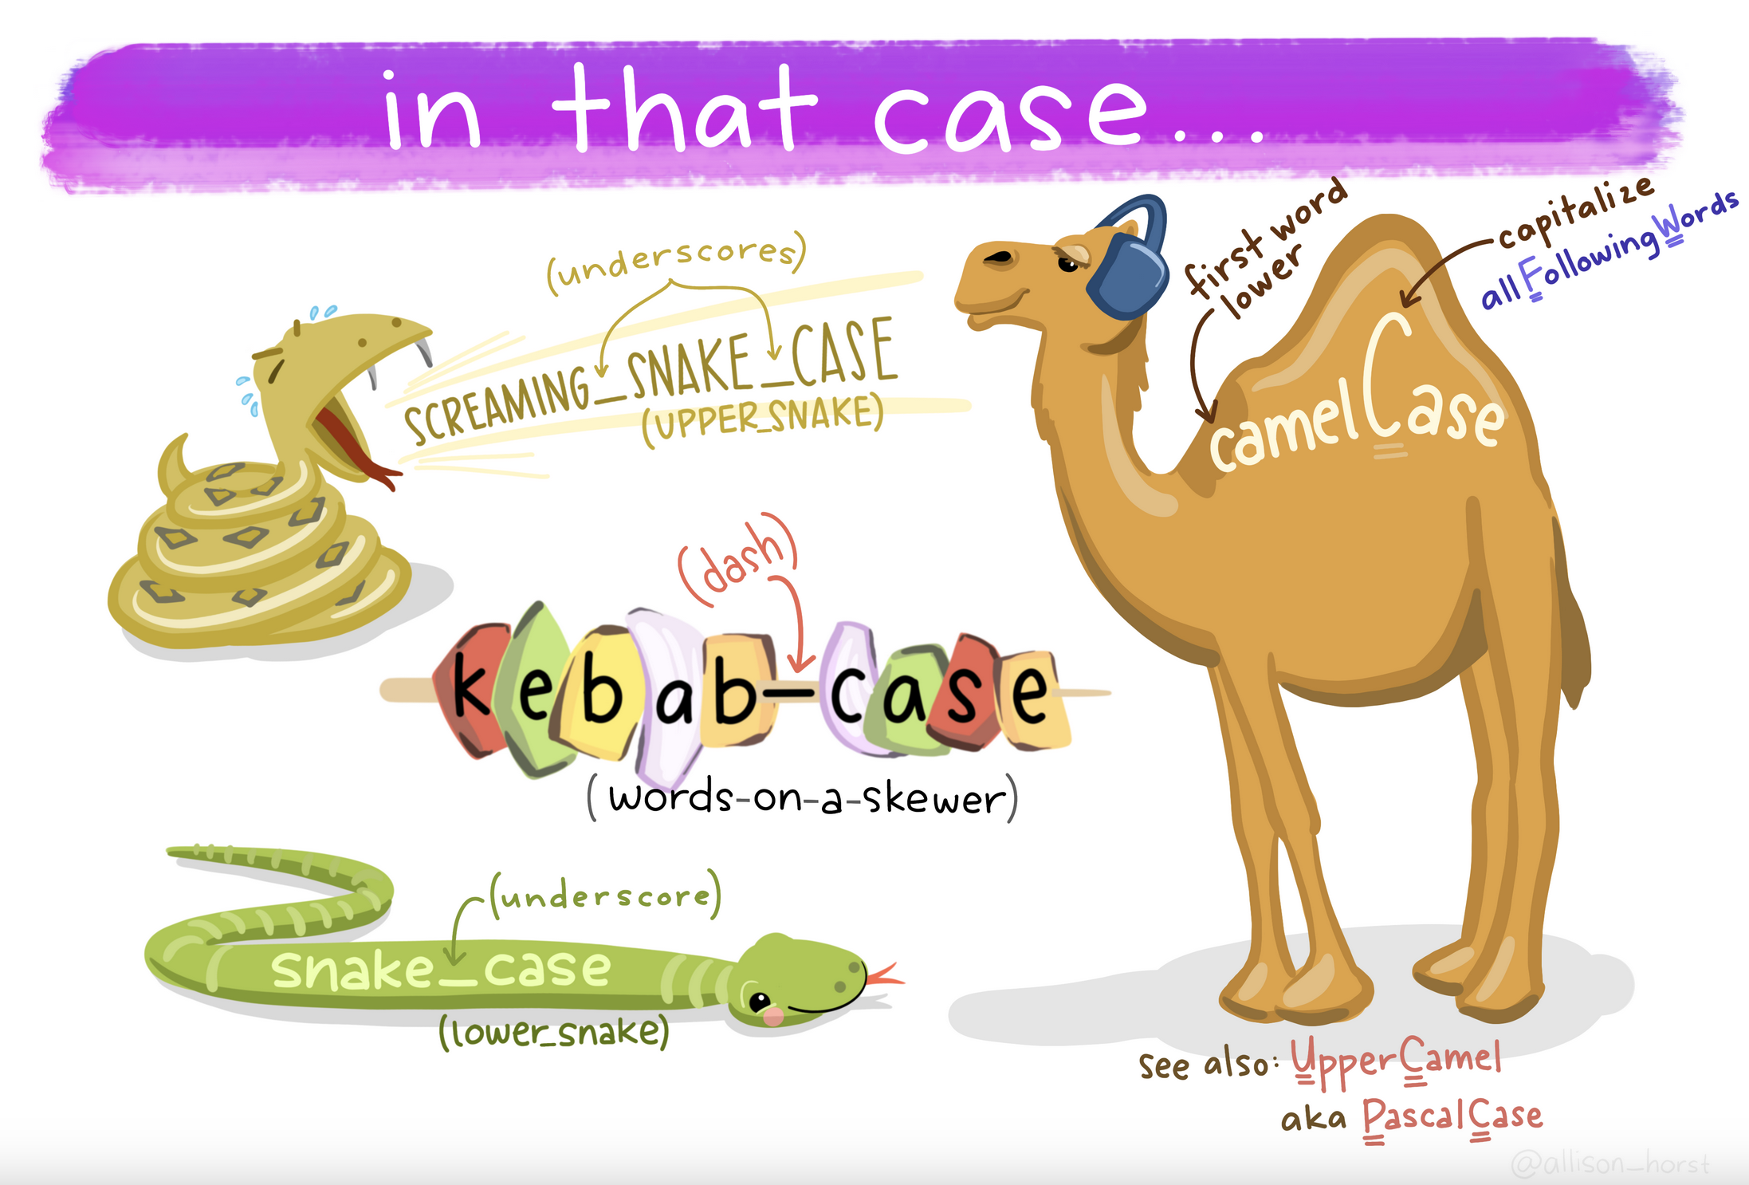
Artwork by Allison Horst
https://allisonhorst.com/everything-else

Slide 48
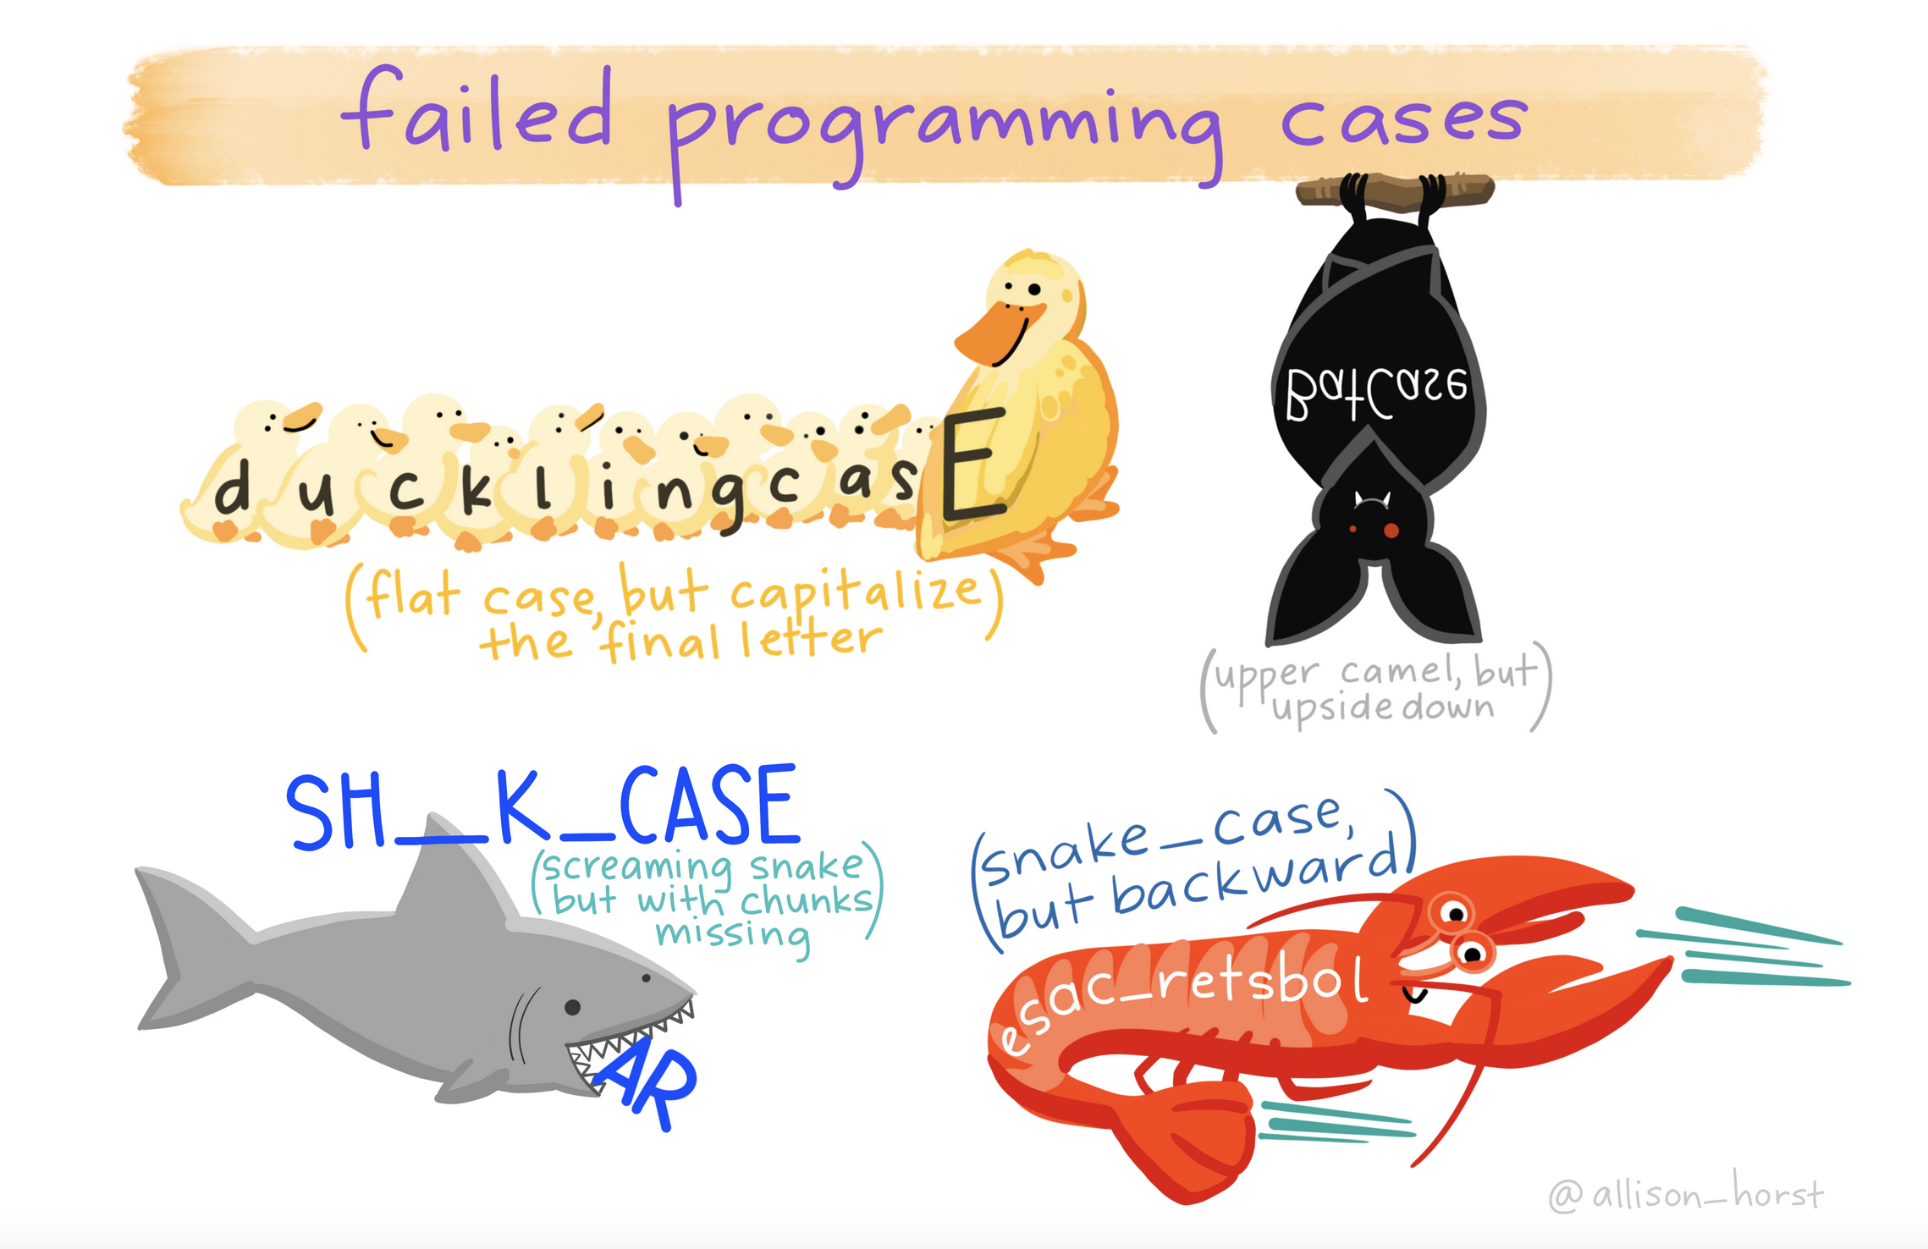
Artwork by Allison Horst
https://allisonhorst.com/everything-else

Slide 49
Now you try!
Create three new objects, with any allowable names you want. Try to use a consistent naming style.
Numeric (we already did this, but practice is good)
String
Logical

Slide 50
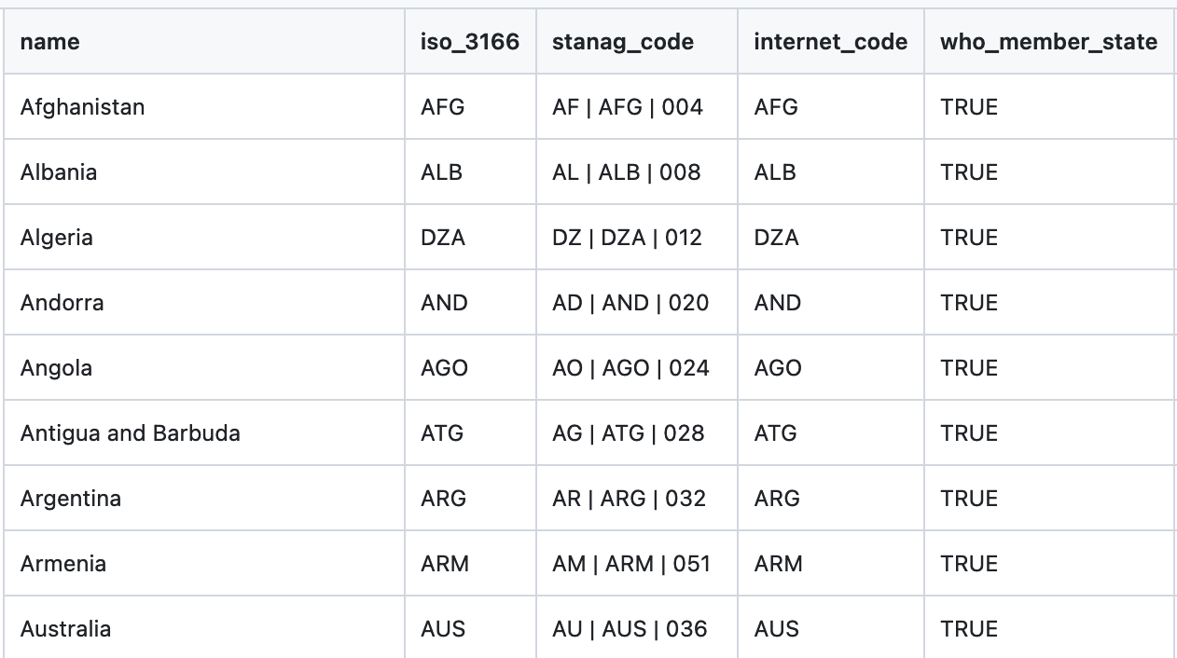
Vectors
Each column is a vector
Vectors are grouped data elements in a specific order
For example, data in a specific column in Excel
When you’ve thought previously about data analysis, you probably think about vectors, even if you didn’t use that name
Notes:
See more information here: https://intro2r.com/using-functions-in-r.html

Slide 51
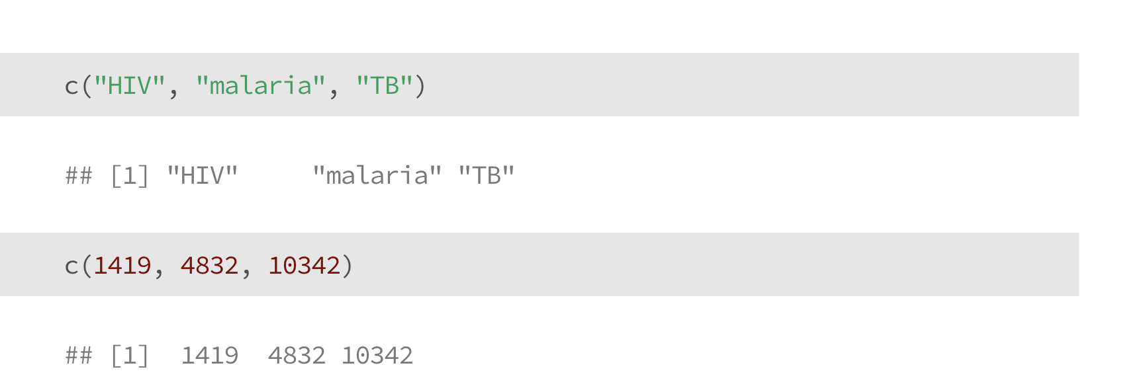
Vectors
Notes:
See more information here: https://intro2r.com/using-functions-in-r.html

Slide 52
Vectors
The c() stands for “concatenate”
Notes:
See more information here: https://intro2r.com/using-functions-in-r.html

Slide 53
Vectors
Vectors can contain strings
Or numbers
Notes:
See more information here: https://intro2r.com/using-functions-in-r.html

Slide 54
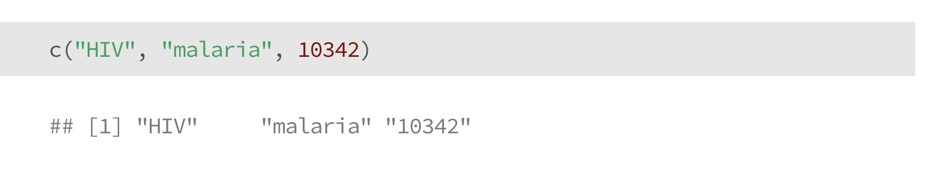
Vectors
Vectors can contain strings
Or numbers
… but not both
What happened here?
Notes:
See more information here: https://intro2r.com/using-functions-in-r.html

Slide 55
Now you try!
Make two vectors in R and assign them to objects.
Numeric
String

Slide 56
Functions
Functions are instructions to perform a task
They are algorithms, or consistent set of rules
R has built-in functions for many basic things
Functions generally look like this: function(object)
We can also “add on” extra functions by loading new libraries (we’ll get to this later), or we can write our own functions to do whatever we want

Slide 57
Functions
Most functions in R are vectorized
This means they act on all items in a vector
Why does this matter?
If you misunderstand it, your math will be wrong
It’s useful for basic calculations and analysis:
divide all numbers by 100 to calculate a %
multiply per-capita rates by total population

Slide 58
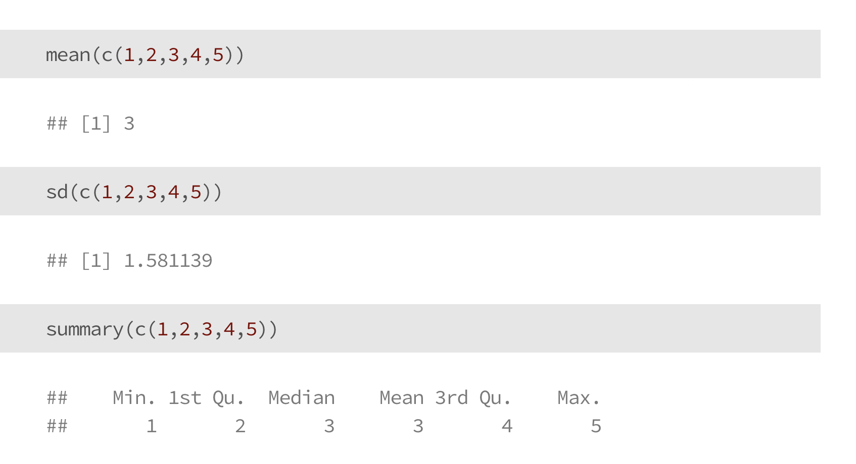
Functions

Slide 59
Functions

Slide 60
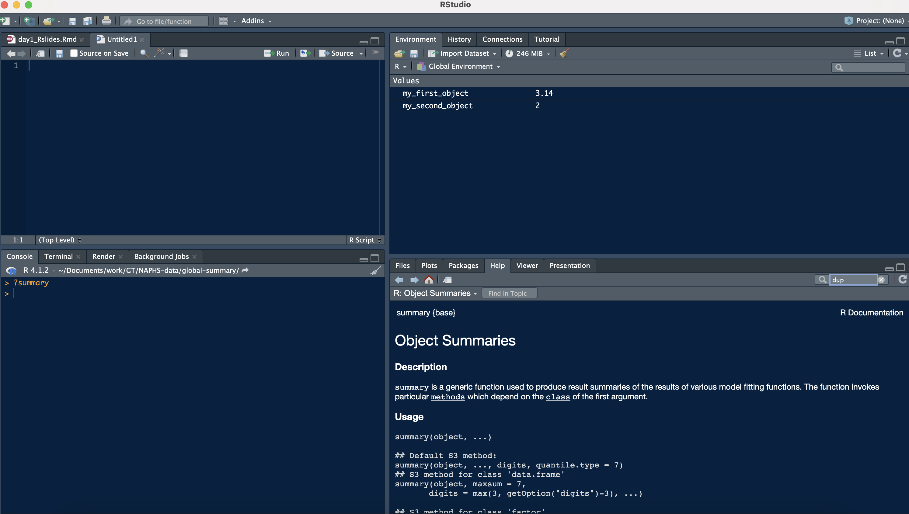
Learn more about functions
?summary or help(summary)
This is documentation about the summary() function
Type ? and then the function name:
?summary
?sd
?mean
etc…

Slide 61
Now you try!
Take the average of three or more numbers
Use “?” to learn more about the function sd()

Slide 62
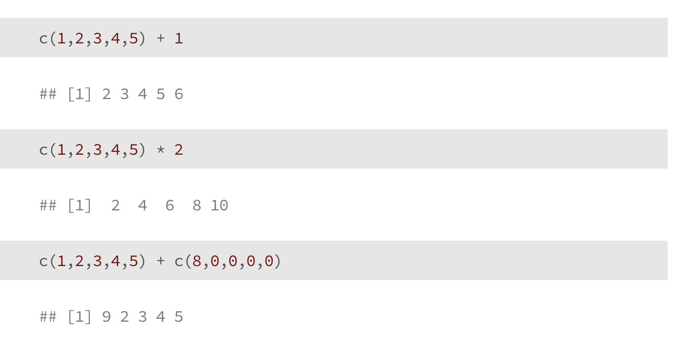
Vectorized Calculations

Slide 63
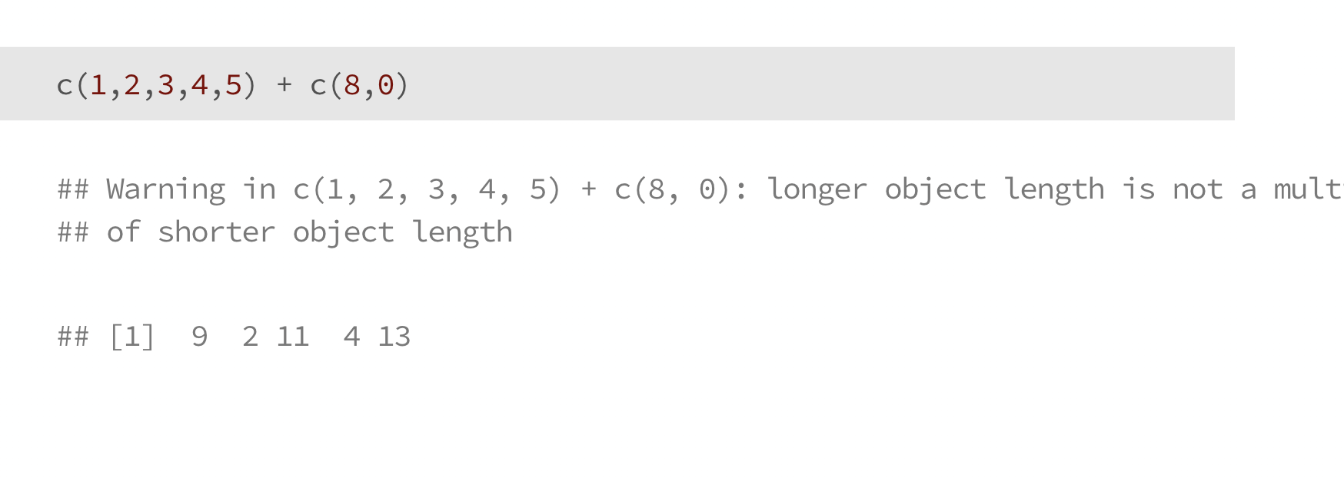
Vectorized Calculations

Slide 64
Syntax
R is case sensitive (‘A’ is different than ‘a’)
Commands are separated by a new line
# marks comments, this code won’t run

Slide 65
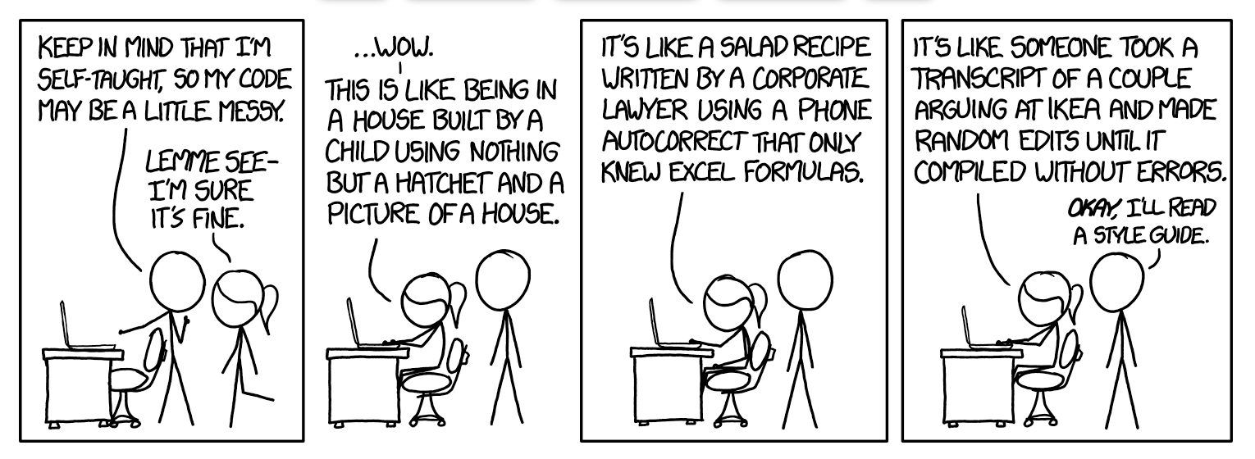
Documenting your code
As we start writing code, it’s helpful to leave “notes” for yourself and others reminding yourself what you did
Comments can also help break code into sections

Slide 66
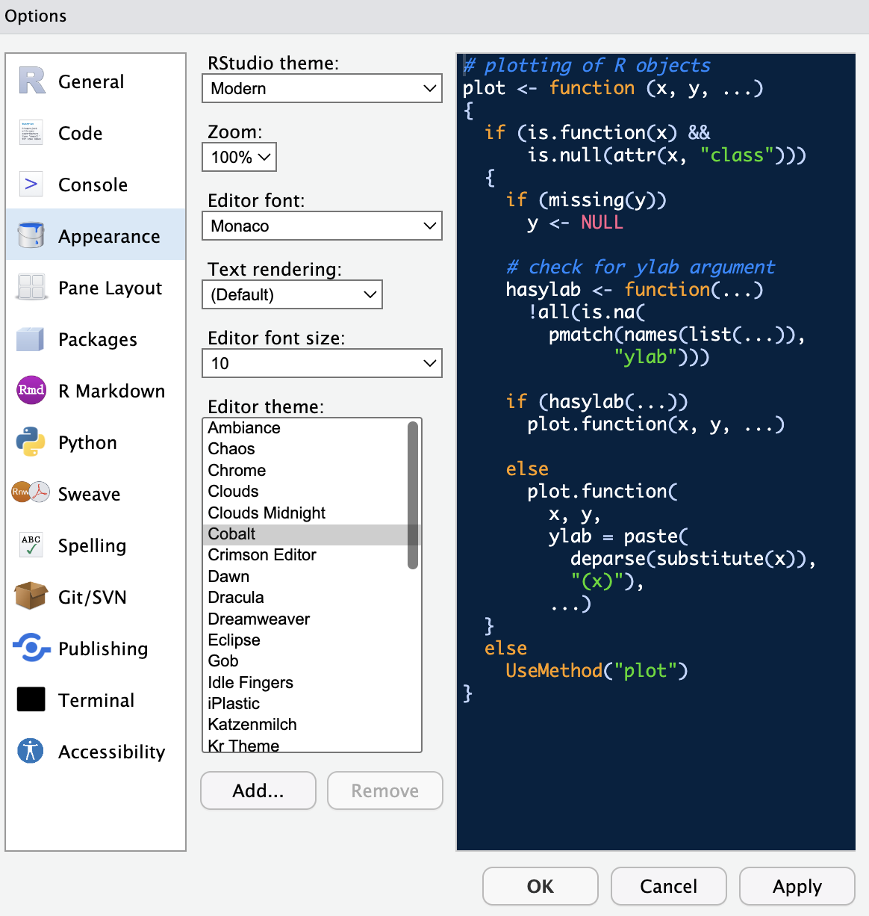
Changing R Studio Appearance
Navigate from the top bar
-> Tools
-> Global options
-> Appearance
(then click “apply”)

Slide 67
Thank you!
See you tomorrow.
Please come with a fully charged laptop.
Lecture and course material adapted from Intro to R materials created by Alex Douglas, available online here, with corresponding free online textbook.

